Slide 1
COMP6230: Cybersecurity
Oli Bills
ofb@ecs.soton.ac.uk

Slide 2
Last Week
Introduction to web application security
Tools and techniques
Put the basics into practice
SQL injection
Cross-site scripting
Parameter manipulation
Cookie manipulation
Insecure authorisation

Slide 3
Today
How to be a hacker
Vulnerabilities in more detail
Out of date software
Information Leakage
Session Vulnerabilities
SQL Injection
Cross-site Scripting
Cross-site Request Forgery
Authentication Bypass & Authorisation Bypass
File Upload Vulnerabilities
We’ll attack another piece of software

Slide 4
Things to think about
1: Be systematic
2: Be Logical
3: Map out what you’re doing
4: Use tools to help you
5: Be the anti-user
6: Intercept and Manipulate
7: Cheat
8: Don’t give up

Slide 5
1: Be Systematic
Know what you’re looking for!
Work through the vulnerabilities
Remember the top vulnerabilities to look for, and work from there
Out of date software
Information Leakage
Session Vulnerabilities
SQL Injection
Cross-site Scripting
Cross-site Request Forgery
Authentication Bypass & Authorisation Bypass
File Upload Vulnerabilities

Slide 6
1: Still being systematic
Out of date software
Can we find out what software is running?
Can we find vulnerabilities for that software?
Can we find exploit code for that software?
Information Leakage
Can we find anything that’s hidden on pages?
What are the error messages like?
What are the unexpected error messages like?
Session Vulnerabilities
What are the sessions like?
Are they using their own system or the language built in sessions?
Some people think they can make something “better”
They usually fail

Slide 7
1: Systematic being still
SQL Injection
What parts of the site use the database?
What inputs do I have into those parts?
Cross-site Scripting
Where can I input data into the site?
Where am I inputting data into the site without realizing?
Cross-site Request Forgery
GET requests aren’t supposed to change state
Can you find any GET requests that do?
Do the forms seem protected?

Slide 8
1: Bill seeing systematic
Authentication Bypass & Authorisation Bypass
What should I be able to do as a guest/user/admin?
What can I actually do?
Is the process protected the whole way through?
The button
The page/form
The processing
File Upload Vulnerabilities
Upload ALL THE FILES!
Fake fake fake fake!
Fake the content, fake the type, fake the filename, fake the headers, fake the properties – fake it all!
And then fake some more!

Slide 9

Ok, let’s go a little faster now

Slide 10
2: Be Logical
Continuing from being systematic
Think about
What is the code doing?
What interactions are taking place?
Where could the vulnerabilities be?
There are certain places they tend to linger…

Slide 11
2: Be Vulcan
What might we have in the database?
Which parts take user input?
Which parts of the site does this occur on?
Now we have an attack base!

Slide 12
3: Map out what you’re doing
You are testing a system you have never seen before – it’s like going to a new city
Before diving in trying to find and exploit things, you want to map out the system
Use the tools to help you do this
But sometimes some pen and paper is good too
Be your own spider!

Slide 13
3: Map out what you’re doing
What areas of the website are there
How does each area link to each other
What forms do they have
What inputs are there
How are they accessed
What URL parameters are there
What GET parameters are there
What are the different types of pages
Static pages
Dynamic pages
Logic

Slide 14
3: Map out what you’re doing
Home page
About page
Services page
My accounts
Transactions
Pay bill
Apply for loan
Help

Slide 15
3: Map out what you’re doing
Pages (/pages/display/)
Home (/pages/display/home)
About (/pages/display/about)
Services (/pages/display/services)
Accounts (/accounts)
Transactions (/transactions)
Pay bill (/transactions/bill)
Loans (/loans)
Help (/help)

Slide 16
3: Map out what you’re doing
Tag what we find with what is interesting there
What are we looking for?
Forms [F]
URL parameters [P]
GET parameters [?]
Logic [L]
Uploads [U]
Database [D]
Reflection [R]

Slide 17
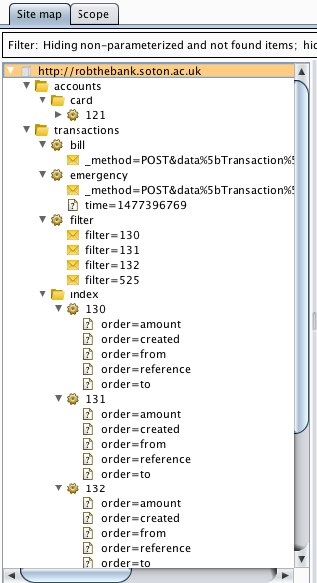
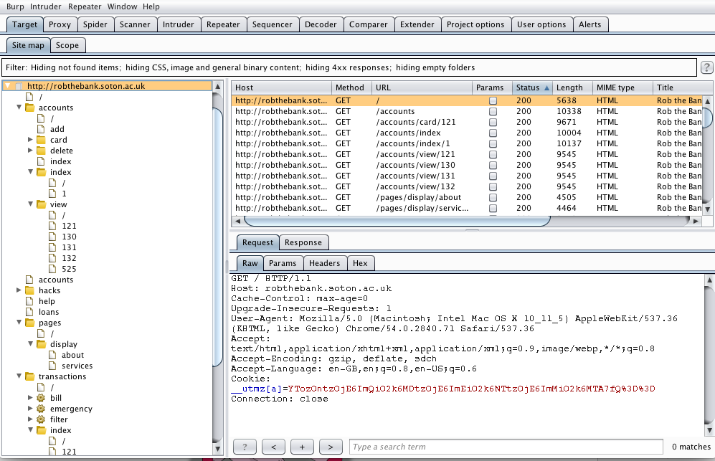
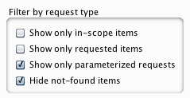

Slide 18
3: Help me tag these!
Forms [F]
URL parameters [P]
GET parameters [?]
Logic [L]
Uploads [U]
Database [D]
Reflection [R]
Accounts (/accounts)
Index (/accounts/index/<page>)
Add (/accounts/add)
View (/accounts/view/<id>)
Card (/accounts/card/<id>)
Close (/accounts/close/<id>)
Transactions
Index (/transactions/index/<id>)
Transfer (/transactions/transfer)
Bill (/transactions/bill)
Emergency (/transactions/emergency?time=…)
Accounts (/accounts)
Index (/accounts/index/<page>) [P]
Add (/accounts/add) [L]
View (/accounts/view/<id>) [P] [R]
Card (/accounts/card/<id>) [P] [F] [U]
Close (/accounts/close/<id>) [P] [L]
Transactions
Index (/transactions/index/<id>) [P] [R]
Transfer (/transactions/transfer) [F]
Bill (/transactions/bill) [F]
Emergency (/transactions/emergency?time=…) [F] [?]

Slide 19
3: Map out what you’re doing
Forms
Edit card
Make transaction
Emergency transaction
Pay bill
…
Reflection
View account
Transaction index
…
Logic
Add account
Close account
…

Slide 20

3: Map out what you’re doing
Then put it into a spreadsheet
You can filter!

Slide 21
4: Use tools to help you
There’s lots of great tools out there
Find the ones that work best for you
There is no perfect tool, just the perfect tool for you
There’s SQL injection helpers
There’s intercepting proxies
There’s collections of exploits for things like XSS
A good starting place is OWASP:
https://www.owasp.org/index.php/Category:OWASP_Project

Slide 22
5: Be the anti-user
You’ve been logical, now it’s time to be illogical!
See a number? Let’s try a string
Or maybe a negative number
Or a number that’s too large for the database
See a value? Let’s leave it empty
Or maybe lose it all together… Oops
See a field? Let’s overflow it
Spam spam spam spam spam
It’s hidden?
So what!
Do all the things they assume you’d never do

Slide 23
6: Intercept and Manipulate
Developer tools for the basics
Burp suite for the more advanced manipulation
Turn on intercepting and see what is being sent and what is being received
Then mess with it!

Slide 24
7: Cheat
People have done a lot of this work before
There’s cheat sheets out there to make your life easy
Particularly when it comes to XSS
XSS isn’t always as simple as <script>alert(‘hello’)</script>
https://www.owasp.org/index.php/XSS_Filter_Evasion_Cheat_Sheet

Slide 25
8: Don’t give up!
Be exhaustive – it’s not always that simple!
Sometimes you have to be clever
Users puts the URL as
http://blah.png” onMouseOver=“alert(blah);
Run through htmlspecialchars, that’s still
http://blah.png” onMouseOver=“alert(blah);
So when it bungs the url inside the <img> tag, we get
<img src=“$url”/>
<img src=“http://blah.png” onMouseOver=“alert(blah);”/>
And when the user moves the mouse over the image they execute the javascript!

Slide 26
Rob the Bank
SQL Injection
Information Exposure
XSS
File Upload
CSRF

Slide 27
Rob the Bank
Authorisation Bypass
Internal Information
Parameter Manipulation
Application Logic
Out of Date Software

Slide 28
Rob the Bank
File Inclusion
Cookie Manipulation
Open Redirects
Exposed API
Backdoors

